Slide 1
CSE460: VLSI Design
Lecture 15+16: VLSI Physical Design
Routing Algorithm

Slide 2
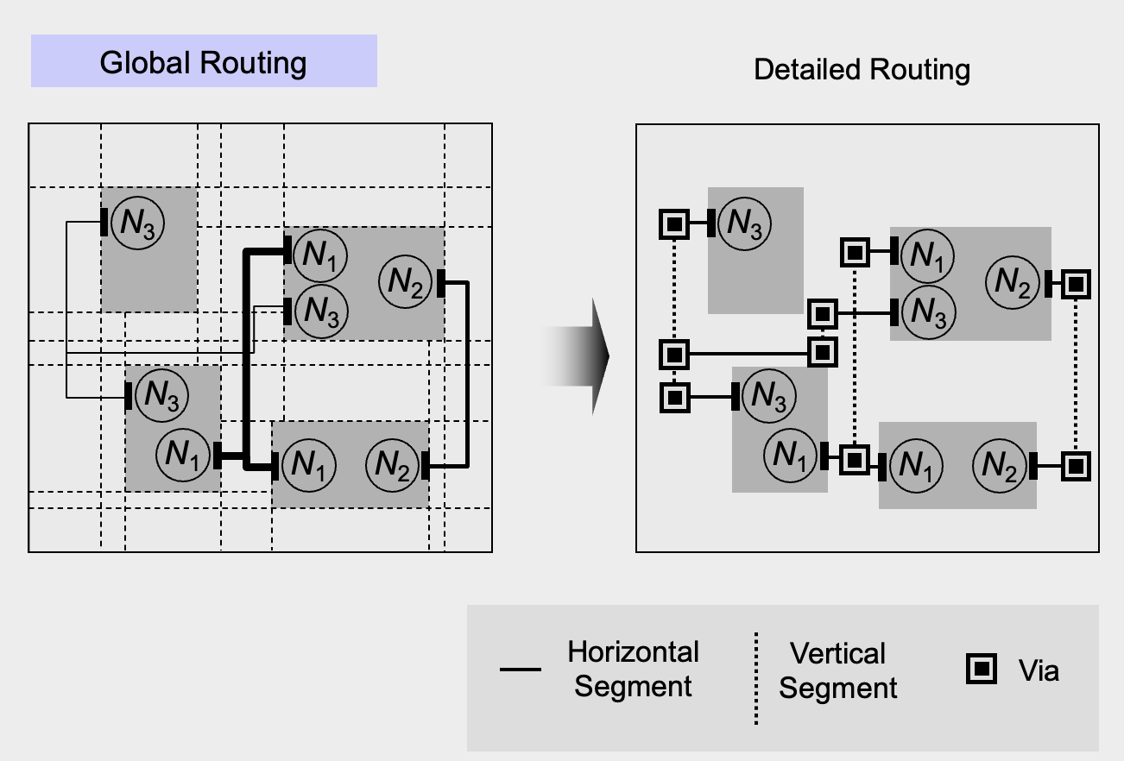
Introduction
Forming physical connection between pins. First, approx. path (Global Routing), then, placing metal line segment (Detailed Routing)
After placement phase, the exact locations of circuit blocks and pins are determined.
Space not occupied by the blocks are used for routing and are called as routing regions.
Two kinds of approaches to solve global routing problem: Sequential & Concurrent Approach.

Slide 3
Routing Approaches
Sequential Approach:
In this approach, as the name suggests, pins are routed one by one.
Order is important: once a region has been routed it may block other
nets which are yet to be routed.
Eg.
i. Maze routing algorithms
ii. Line-probe algorithms
iii. Shortest path based algorithms
Concurrent Approach:
This approach avoids the ordering problem by considering routing of
all the nets simultaneously.
Computationally sophisticated as memory requirement is very high due to parallel operation.

Slide 4
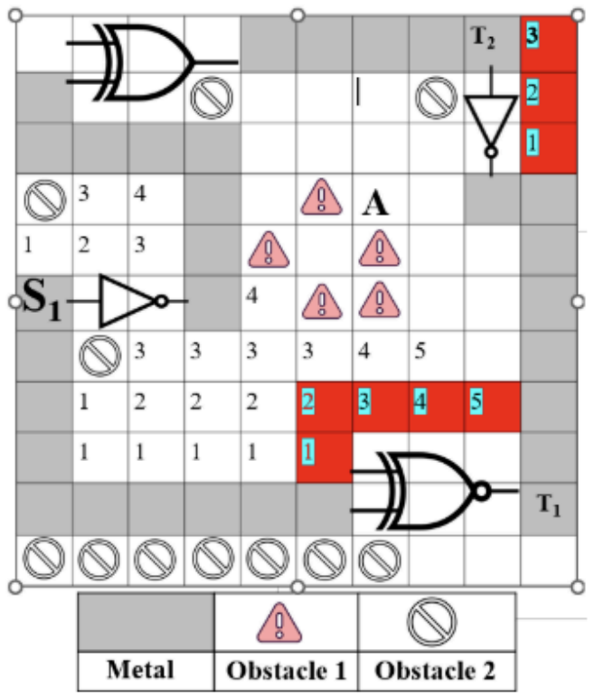
Here, multiple square cells are occupied by a single gate. Hence, each source or target pin is occupied by a single square cell as shown in the picture.

Slide 5
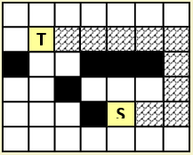
Lee’s Maze Routing algorithms
The layout surface is assumed to be made up of a rectangular array of grid cells.
Each Grid cell represents a square cell where one wire can cross.
Objective is to find out the shortest path (sequence of grid cells) for connecting two points (Source, S to Target, T) .
When using cells, a wire can either cross or bend.
Some of the grid cells act as obstacles (Black Cells).
-Blocks that are placed on the surface.
-Some nets that are already laid out.
cross
Bend

Slide 6
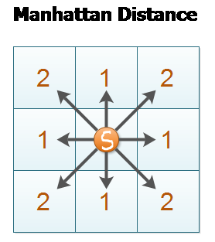
Lee’s Algorithm : Expansion
Step 1: Wave propagation -
Iterative process
Starts at the most adjacent cell of the Source.
Need to find all new cells/grid that are reachable at pathlength 1(i.e, all paths that are just 1 unit in total length(just 1 cell)).
Using the pathlength 1 cells, all new cells which are reachable at pathlength 2 can be found.
Process is repeated until the target, T is reached.
During i^{th} iteration, non‐blocking grid cells at Manhattan distance of i from grid cell S are all labeled with i
2
1
2
1
2
1
1
S
2 1 S 1 2
Note: Manhattan distance is the number of strides (horizontal and/or vertical) required to reach a cell.
1
2
1
2
2
adjacent cell

Slide 7
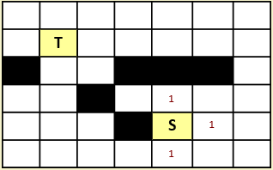
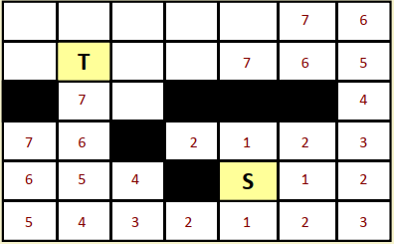
Lee’s Algorithm
Step 1: Wave propagation (contd)-
Labeling continues until the target grid cell T is marked in iteration L (i.e. when i=L0).
L0 is the length of the shortest path.
i = 1
The process fails if:
- T is not reached and no new grid cells can be labeled during step i.
- T is not reached and i equals M, some upper bound on the path length.
i = 7

Slide 8
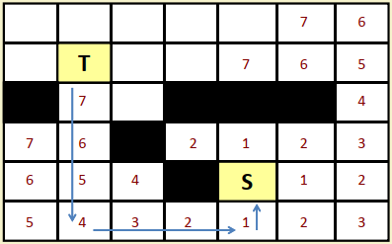
Lee’s Algorithm
direction change means going to the 4 in the right from 5 instead of 4 in it’s below position
Step 2: Retrace-
Systematically backtrack from the target cell T back towards the source cell S.
If T was reached during step i, then at least one grid cell adjacent to it will be labeled i‐1, and so on.
By tracing the numbered cells in descending order, we can reach S following the shortest path.
In practice, the rule of thumb is not to change the direction of retrace unless one has to do so.
Minimizes number of bends to reduce system complexity.

Slide 9
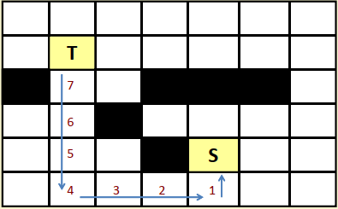
Lee’s Algorithm
Step 3: Label clearance-
All labeled cells except those corresponding to the path just found are cleared.
Cells along the path are marked as obstacles.
Search complexity is as involved as the wave propagation step itself.

Slide 10
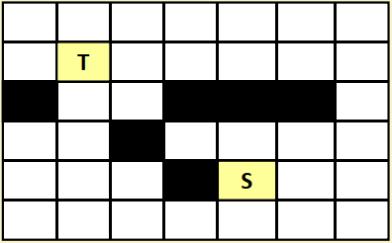
Example 1
Initial routing problem:

Slide 11
Example 1
Step 1: Wave propagation
i = 1

Slide 12
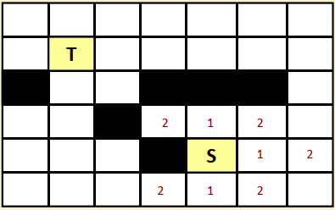
Example 1
Step 1: Wave propagation
i = 2
just proceed one manhattan distance horizontally/vertically from cells labelled as ‘1’

Slide 13
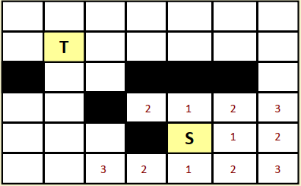
Example 1
Step 1: Wave propagation
i = 3

Slide 14
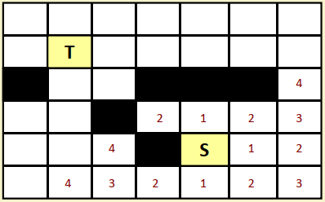
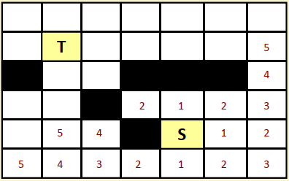
Example 1
Step 1: Wave propagation
i = 4
i = 5

Slide 15
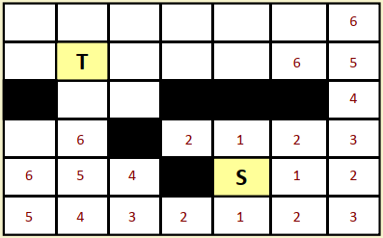
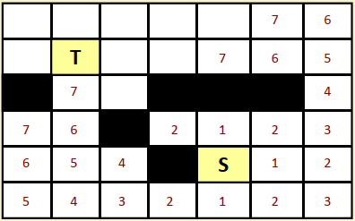
Example 1
Step 1: Wave propagation
i = 6
i = 7

Slide 16
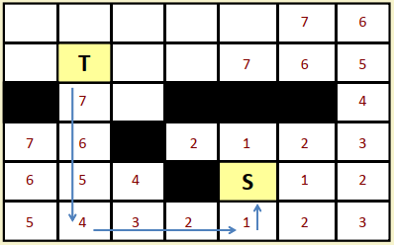
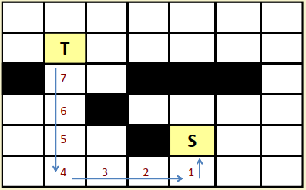
Example 1
Step 2: Backtrace
Step 3: Clear

Slide 17
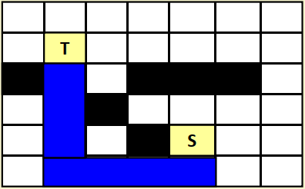
Example 1
Final output (Mark):
Marked region is now blocked.
New wave cannot propagate through this merged region unless the same S has another target T.
If the source has another target T, then whole marked (blue) region will be considered as Source, S which we will explore in Example 2.

Slide 18
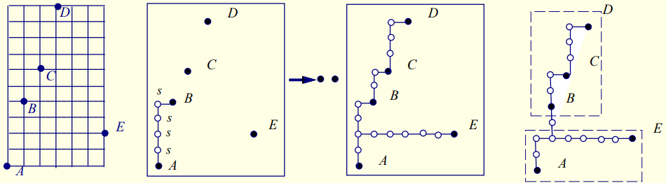
Multi-Terminal Nets
Step 1: Propagate wave from the source s to the closet target.
One of the terminals (A; out of 5) of the net is treated as source, and the rest as targets.
A wave is propagated from the source until one of the targets is reached.
Step 2: All the cells in the marked path are next labeled as source cells,(total path from A-B is considered as 1 source) and the remaining unconnected terminals as targets.
Step 3: Propagate wave from ALL s cells to the other cells.
Step 4: Continue until all cells are reached.
Step 5: Apply heuristics to further reduce the tree cost
Fig: (a) A as source; B-E as targets (b) A-B as source; C-E as Targets. (c) all paths from source to target were found (d) optimized path from A-B (low bend)

Slide 19
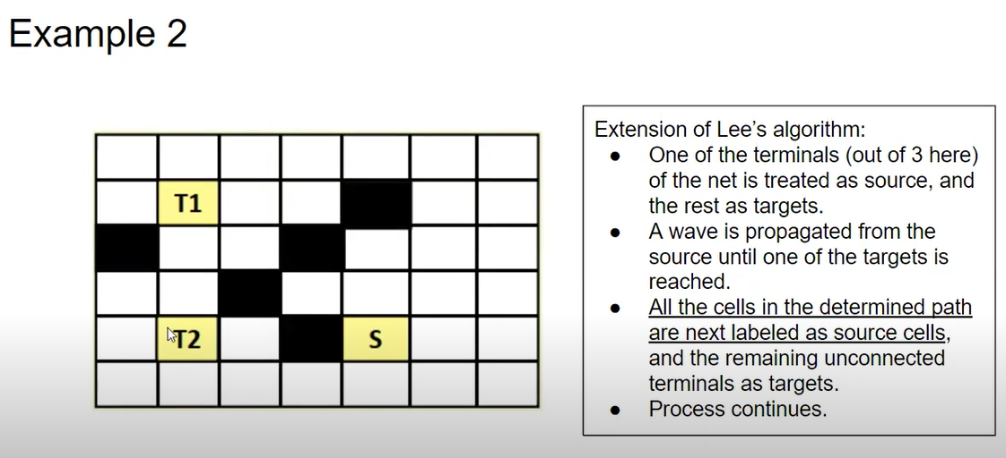
goal: same S must be connected to T1 and T2

Slide 20
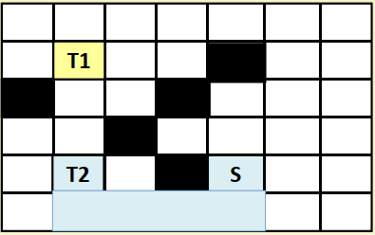
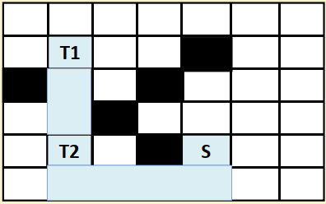
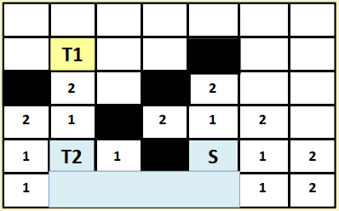




Example 2
Step 1 to 3:
Step 1 to 3 (Again):
this whole metal bar now acts as the source
Ref. [1]

Slide 21
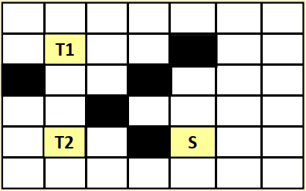
Example 2: Extension of Lee’s algorithm[Multi point nets/ Target]
(a) Initial state
(b) Finding Path-1; From S to T2

Slide 22
Example 2 : [Multi point nets/ Target]
(c) S-T2 path as a source, S1 for T1
(d) Finding Path-2; From S1 to T2

Slide 23
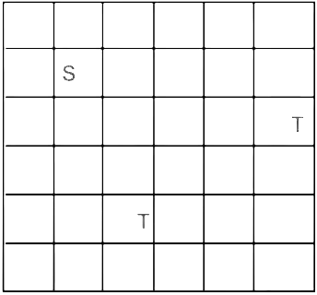




Example 3: CW/HW
Find the shortest path for each Target.
Calculate the memory usage.

Slide 24




Example 3: CW/HW
if we take the green colored path, we would need to fill additional 3 grids with metal to reach the second target instead of 2 grids while taking the blue path as shown in the next slide. Hence, it’s not the optimum result

Slide 25














Slide 26
Memory Requirement
Each cell needs to store a number between 1 and L, where L is some bound on the maximum path length.
For M x N grid, L can be at most M+N‐1.
Two things yet to be denoted: empty cell/obstacle.
So, n = ceil(log₂(L+2)) bits per cell
Total memory = (M x N x n) bits
 |  |  | 6
 |  |  | 5
1 | 2 | 3 | 4
Here, 3 x 4 grid, 3 bits(000=blank; 111 may mean obstacle; 6==110,5=101 etc) are required per cell Total memory = 36 bits

Slide 27
Memory Requirement
Examples:
1. 2000 x 2000 grid
n = ceil(log₂ (4001) )= 12
Memory required = 2000 x 2000 x 12 bits = 6 Mbytes
2. 3000 x 3000 grid
n = log₂ (6001) = 13
Memory required = 3000 x 3000 x 13 bits = 14.6 Mbytes
Note: For memory requirement calculations, the maximum path length (L) is always considered to be (M+N-1) if the sequence is a series of natural numbers (1,2,3,4,5,....). Actual path length can be lower or equal to this value. If we use a repeating sequence, L is total number of unique entity.

Slide 28
Memory Optimization
Akers’s Observations (1967)
Adjacent labels for k are either k − 1 or k + 1. Need a labeling scheme such that each label has its preceding label different from its succeeding label.
WAY 1
Instead of using the sequence 1,2,3,4,5,….. for numbering the cells, the sequence 1,2,3,1,2,3,… is used.(L=3)
For a cell, labels of predecessors and successors are different. So tracing back is easy.
ceil(log₂(3+2)) = 3 bits per cell.
2
1
3
3
2
1
3
2
1
2
1
1
3
2
1
2
3
3
2
1
1
2
2
1
3
2
1
2
3
1.5 Mbytes for 2000 x 2000 grid (< 6Mbytes in prev slide)

Slide 29
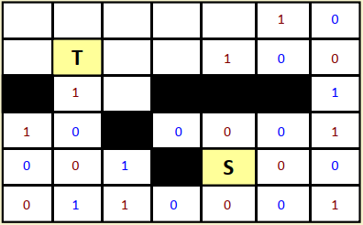
Memory Optimization [Minimum Cost]
WAY 2
Use the sequence 0,0,1,1,0,0,1,1,….., (L=2)
0-> First 0; 1-> First 1.
0-> Second 0; 1-> Second 1.
Predecessors and successors are again different. 0, ,1
ceil(log₂(2+2)) = 2 bits per cell.
0
2000 x 2000 x 2 bits / 8 =1.0 Mbytes for 2000 x 2000 grid
to represent 4 states: blank, obstacle, 0 ,1
Fig: Minimum Bend Path

Slide 30
Memory Requirements - Summary
For memory requirement calculations, the critical path length (L) is always considered to be (M+N-1) if the sequence is a series of natural numbers (1,2,3,4,5,....). Actual path length can be lower or equal to this value.
If we use a repeating sequence, L is the total number of unique entities. For example, if we use 1,2,3,1,2,3... repeating sequence, L = 3.
If the sequence is 0,1,0,1...., L = 2. So, L does not depend on the actual path length for memory calculation.
If you are asked to calculate the memory used by a definite path, that's a different question. Generally, memory requirements denote the maximum memory required to run the algorithm.

Slide 31
Example 4: Using 00110011..… Sequence
Label: 0011001
Retrace

Slide 32
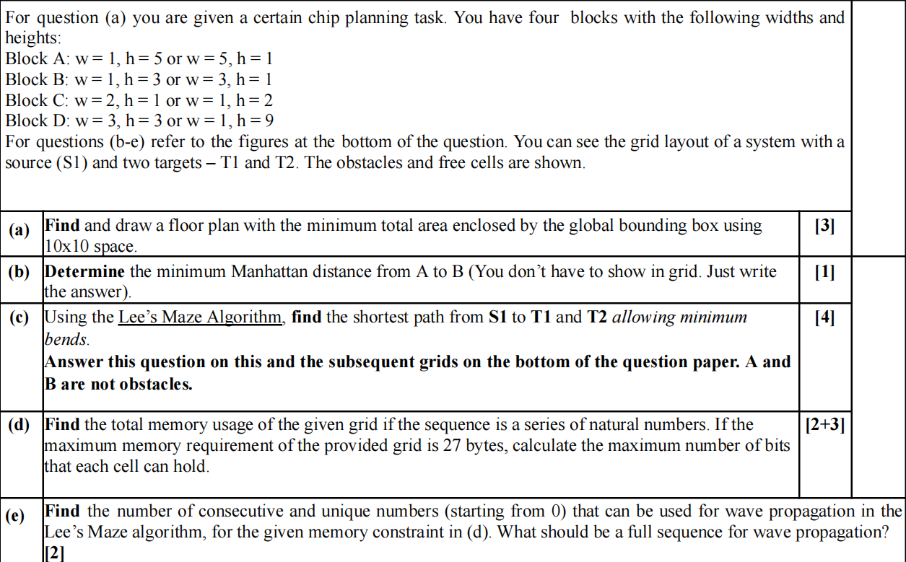
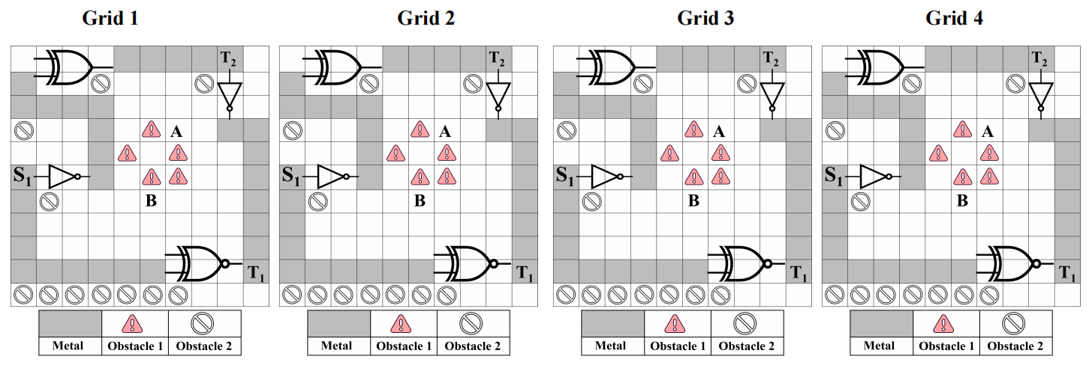
is 28 bytes

Slide 33
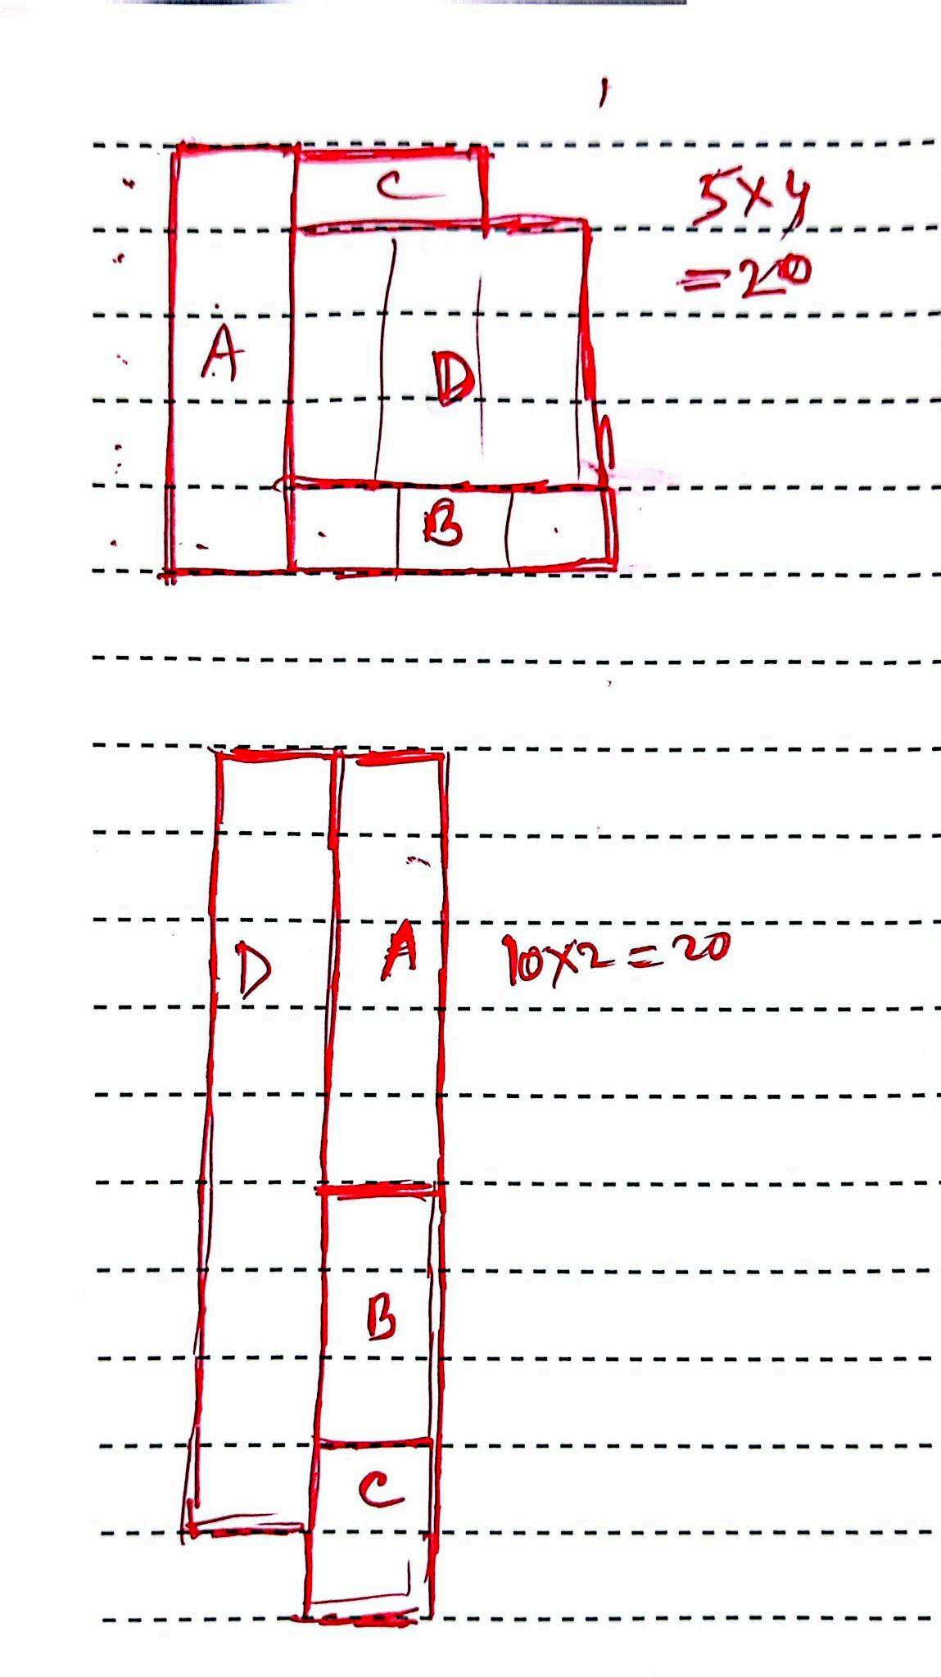
a.
(b) 6 Manhattan Distance (treat the metal layer as
a single node hence till B(not before B)= total = 6
(the cell containing the destination,B must also be considered)

Slide 34
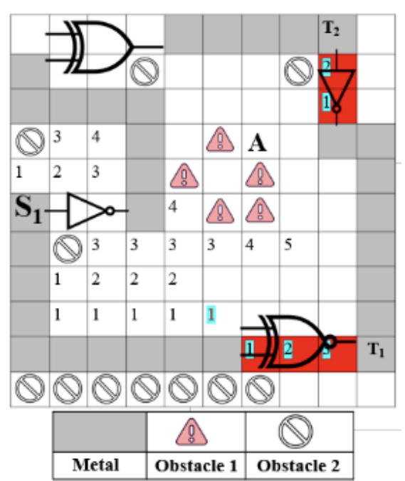
c.
considering gates as obstacles:
by not considering gates as obstacles:

Slide 35
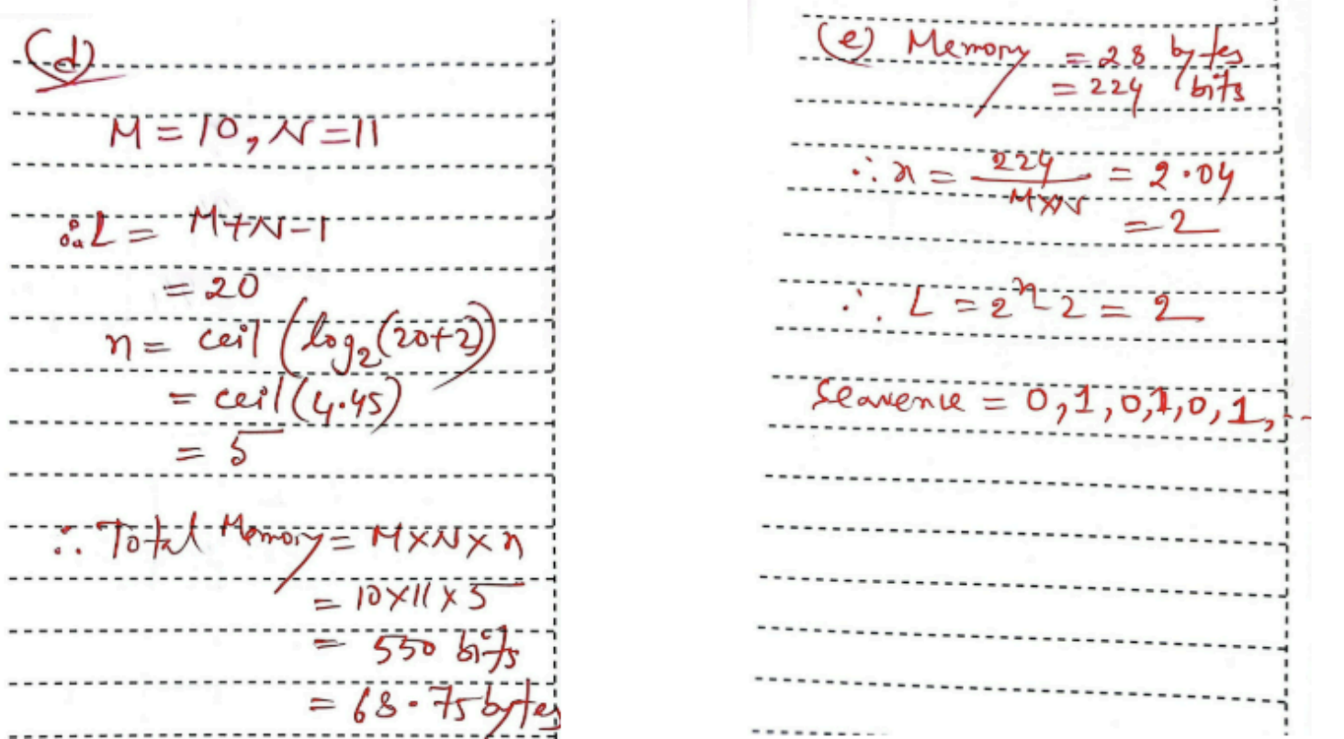

Slide 36
References
Grid Routing- Lecture 16, NPTEL Online certification Courses, IIT Kharagpur.
M. A. Breuer, M. Sarrafzadeh and F. Somenzi, "Fundamental CAD algorithms," in IEEE Transactions on Computer-Aided Design of Integrated Circuits and Systems, vol. 19, no. 12, pp. 1449-1475, Dec. 2000, doi: 10.1109/43.898826.
http://users.eecs.northwestern.edu/~haizhou/357/lec6.pdf

